Slide 1

Data Science
Certification In Data Science Foundation!
CDF Data Analytics Project

Slide 2
Data Analytics : HR Analytics Modelling For Employee Attrition
Problem Statement:
“IBM is an American MNC operating in around 170 countries with major business vertical as computing, software, and hardware.
Attrition is a major risk to service-providing organizations where trained and experienced people are the assets of the company.
The organization would like to identify the factors which influence the attrition of employees and take appropriate steps to curb the attrition.
As a Data Analyst, How can you help IBM management and provide insight and the reasons for the employee attrition, so as management can take a data driven decision to address this challenge!

Slide 3
Work Assignment
As a Data Analyst, you need to prepare a project report for IBM Leadership team and demonstrate the following details. You need to be quite creative and descriptive in your exploration.
Data Analytics Activities (50 Marks – Each 10 Marks)
Find the age distribution of employees in IBM
Explore attrition by age
Explore data for Left employees
Find out the distribution of employees by the education field
Give a bar chart for the number of married and unmarried employees
Plot Graphs: (50 Marks – Each 10 Marks)
Plot Data for Education Field Distribution
Plot Data For Left Employees Breakdown
Plot Data For Exploration – Attrition by age (Use Scatter Plot)
Plot Data For Age (Histogram)
Plot Data For Marital Status (Bar Chart)

Slide 4
IBM Employee Dataset

Slide 5
Data Dictionary
Age: Age of employee
Attrition: Employee attrition status
Department: Department of work
DistanceFromHome
Education: 1-Below College; 2- College; 3-Bachelor; 4-Master; 5-Doctor;
EducationField
EnvironmentSatisfaction: 1-Low; 2-Medium; 3-High; 4-Very High;
JobSatisfaction: 1-Low; 2-Medium; 3-High; 4-Very High;
MaritalStatus
MonthlyIncome
NumCompaniesWorked: Number of companies worked prior to IBM
WorkLifeBalance: 1-Bad; 2-Good; 3-Better; 4-Best;
YearsAtCompany: Current years of service in IBM

Slide 6
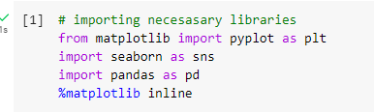

Slide 7
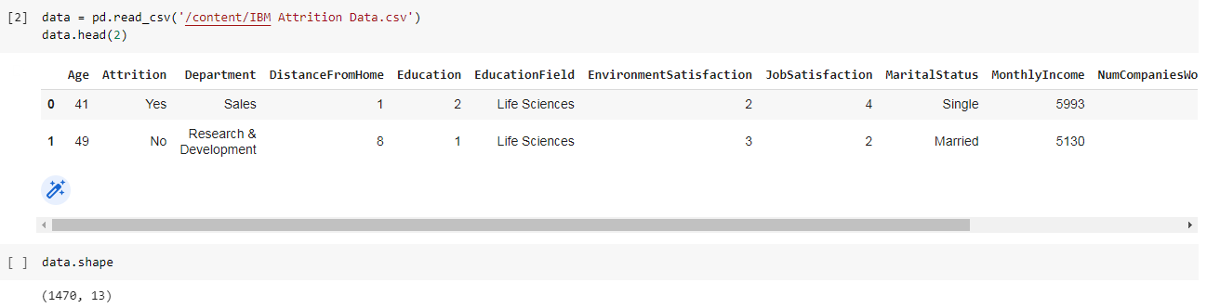

Slide 8
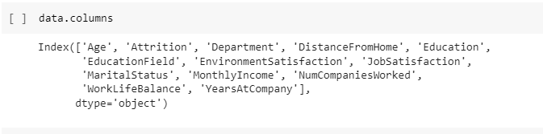

Slide 9
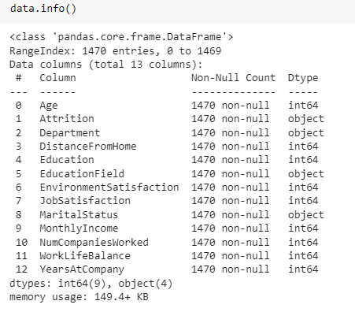

Slide 10
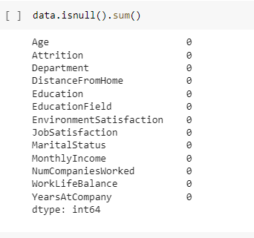

Slide 11
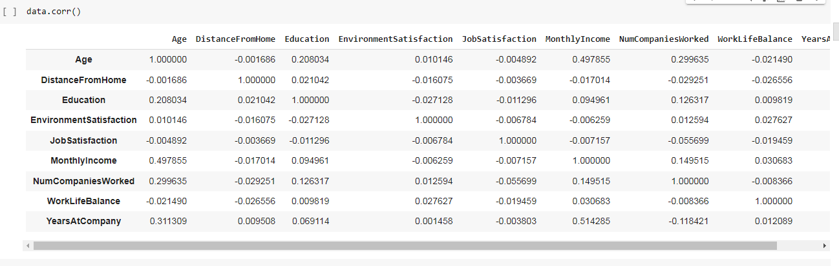

Slide 12
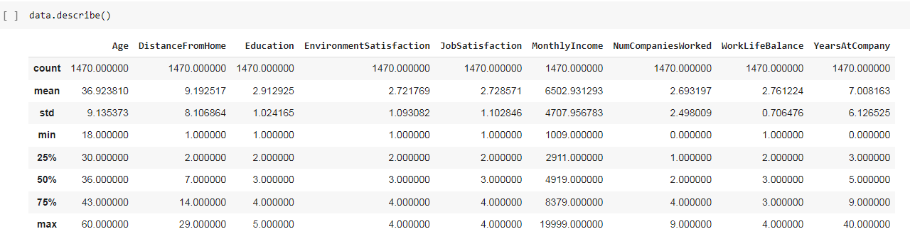

Slide 13
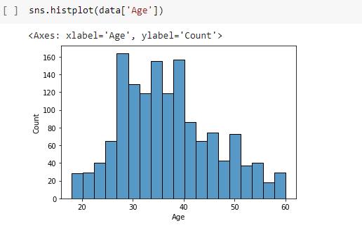

Slide 14
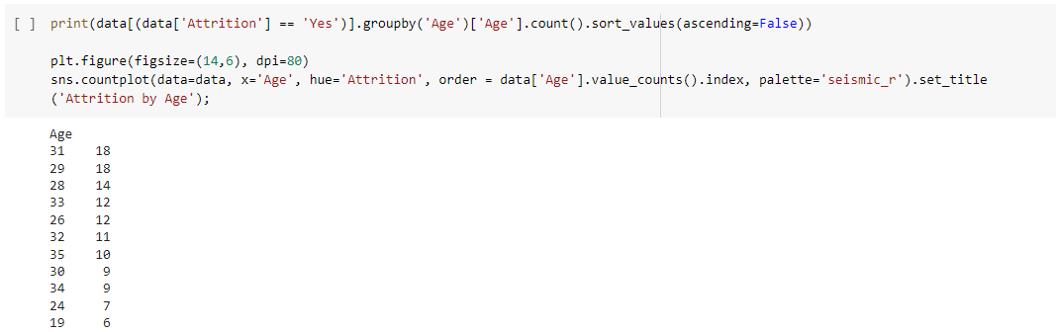
Attrition By Age:

Slide 15
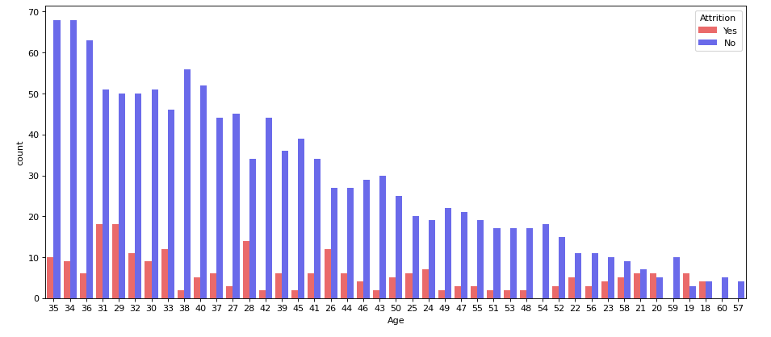

Slide 16
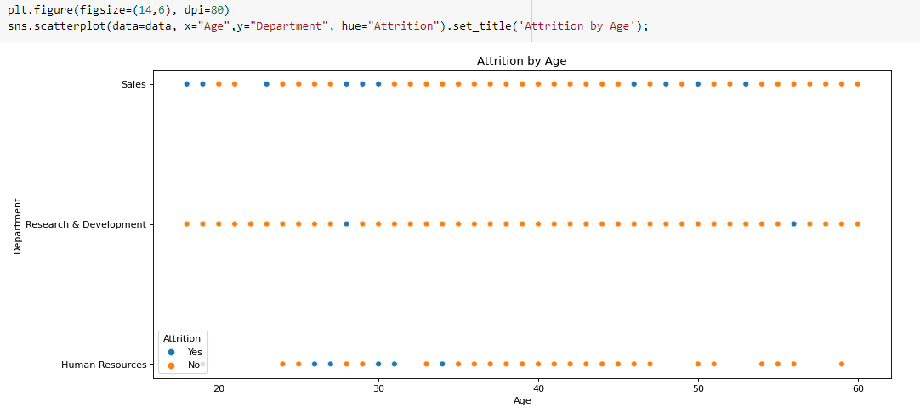
Scatterplot

Slide 17
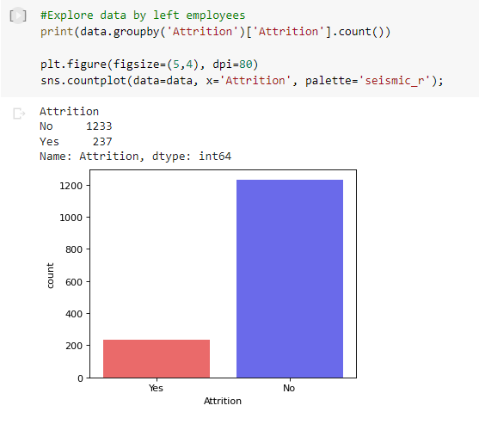
Left Employee

Slide 18
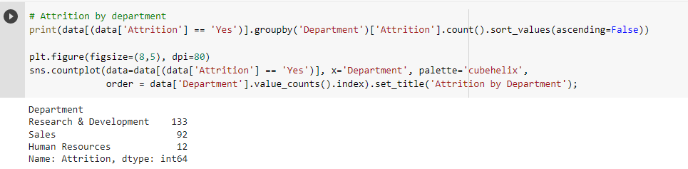
Attrition by deptt

Slide 19
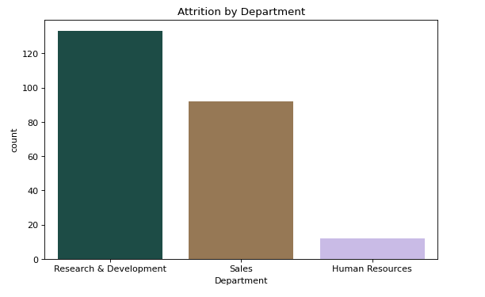

Slide 20
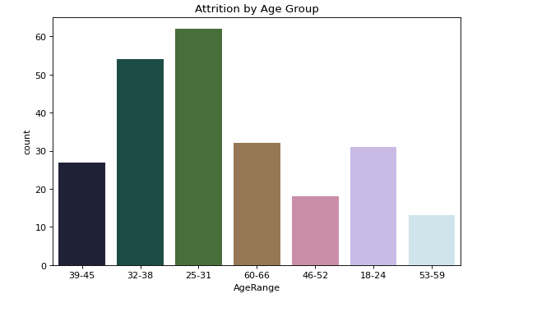
Attrition by age group

Slide 21
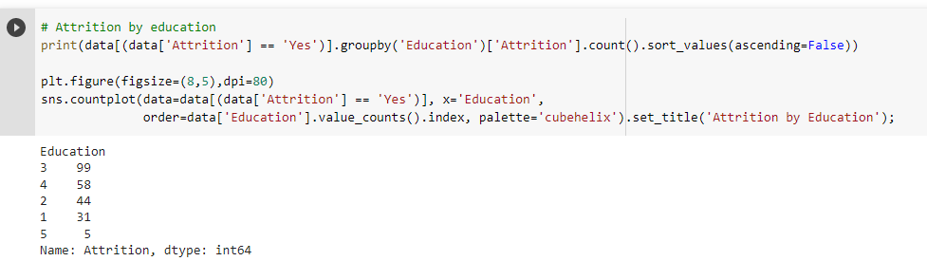
Attrition by Education

Slide 22
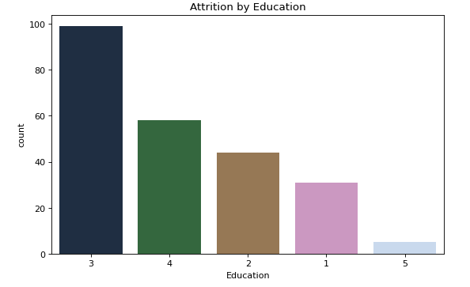

Slide 23
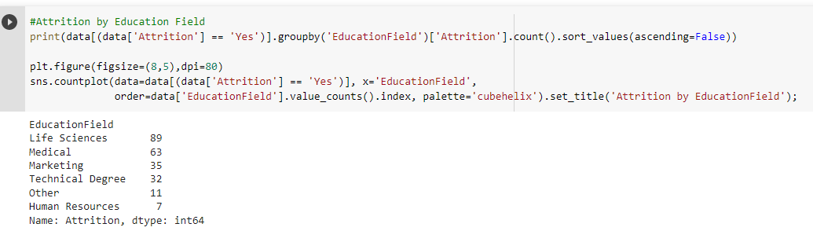
Attrition by Education Field

Slide 24
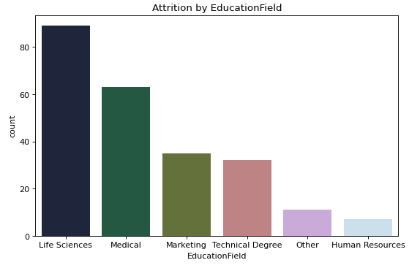

Slide 25
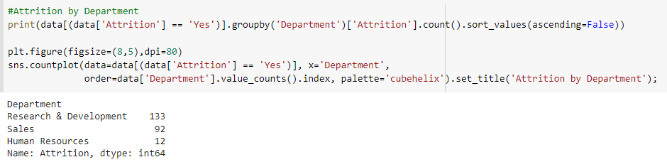
Attrition By Department

Slide 26
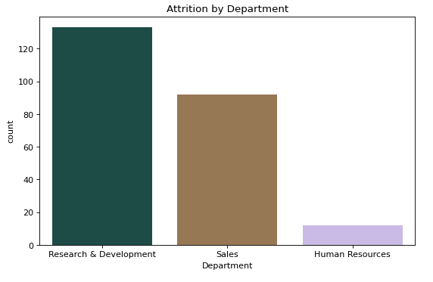

Slide 27
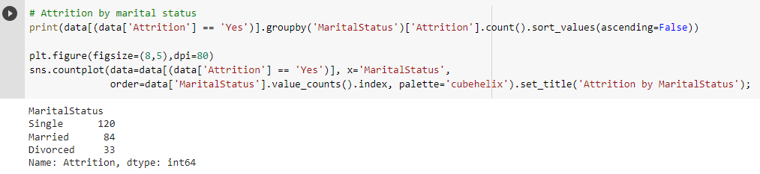
Attrition by Marital Status

Slide 28
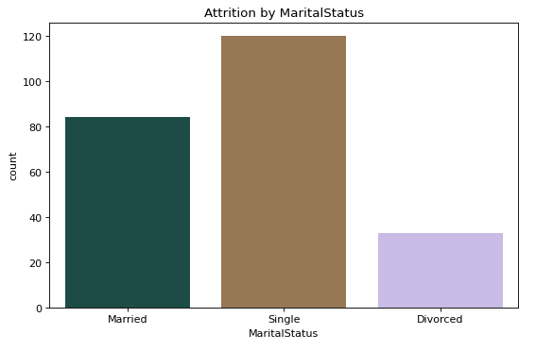

Slide 29
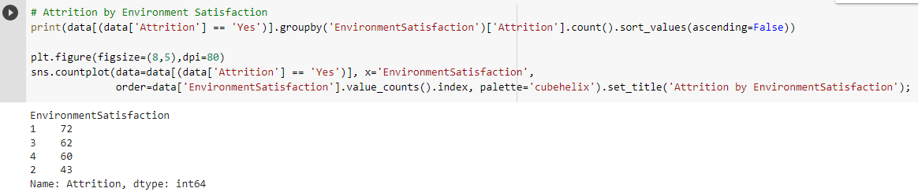
Attrition By Environment Satisfaction

Slide 30
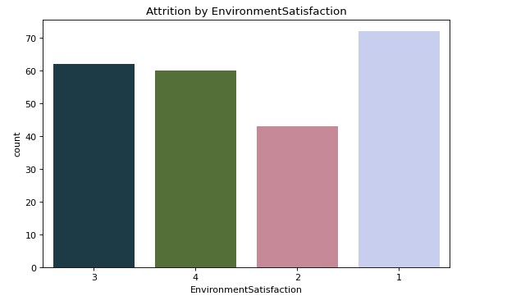

Slide 31
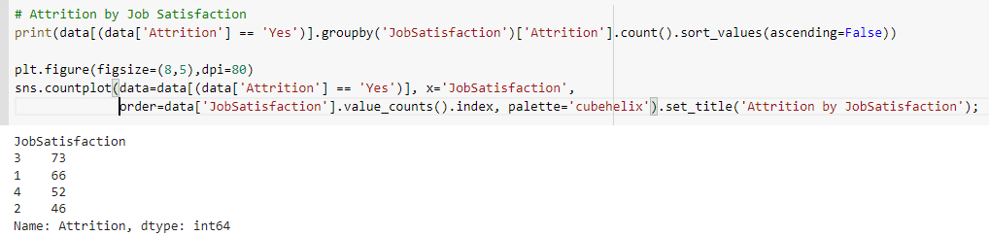
Attrition by Job Satisfaction

Slide 32
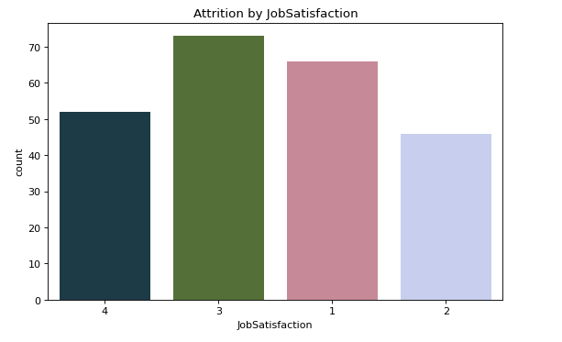

Slide 33
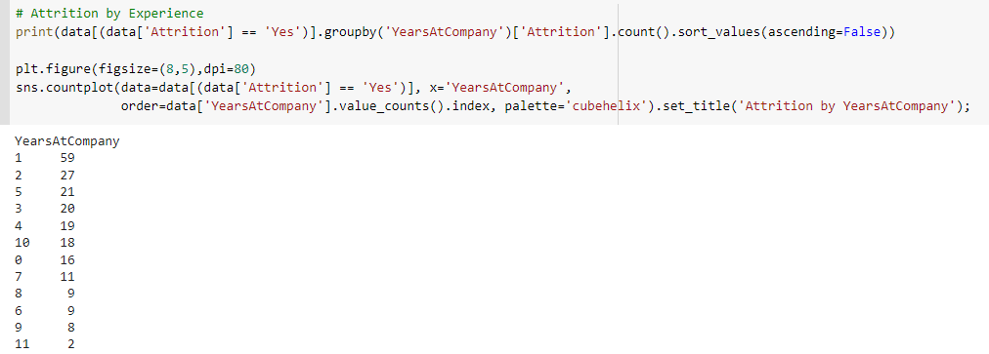
Attrition By Years at Company

Slide 34
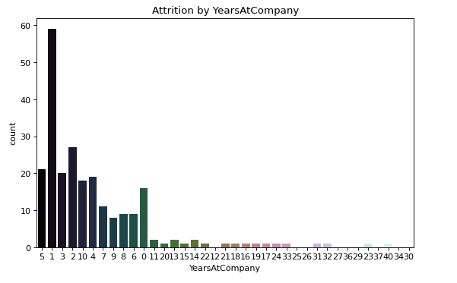

Slide 35
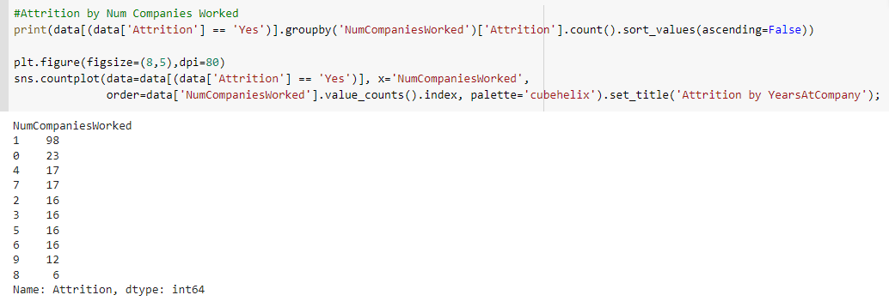
Attrition by Num of Companies worked

Slide 36
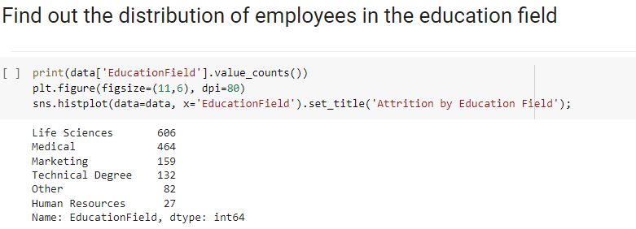
Distribution of employee in Education Field

Slide 37
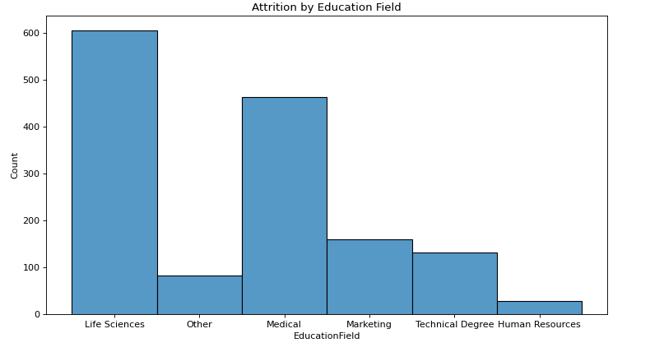

Slide 38
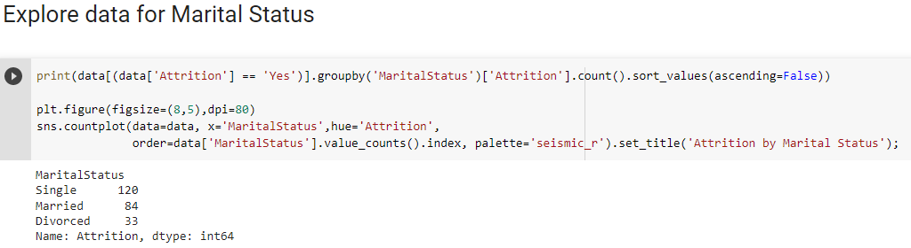
Data for Marital Status

Slide 39
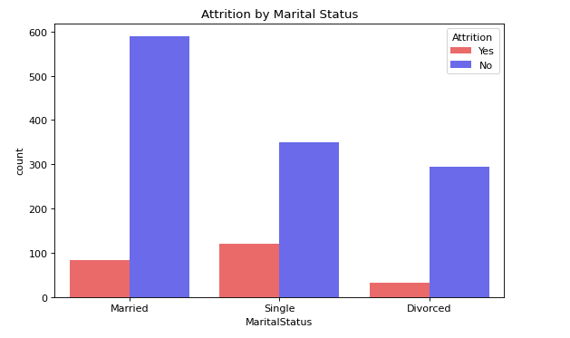

Slide 40
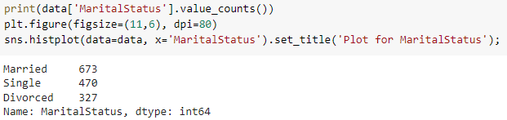
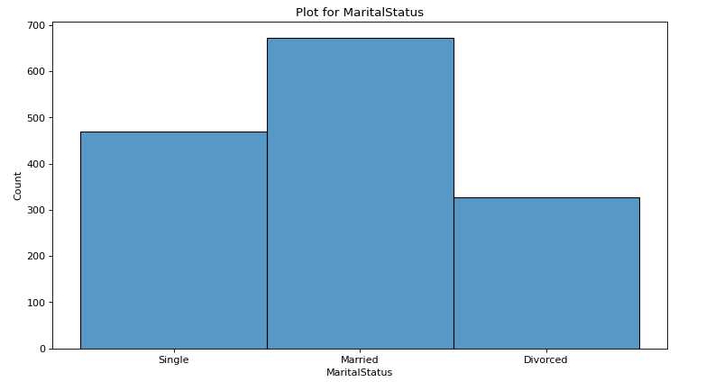

Slide 41
Insights From Data
237 workers quit their jobs. (133 for R&D, 92 for Sales, and 12 for Human Resources)
Employees aged 25–31 (62 employees) are the most likely to have gone.
Those who have completed a bachelor’s degree are more likely to leave. (99 employees)
Those who are dissatisfied with their surroundings are more likely to leave. (72 employees)
Those who are highly satisfied with their jobs are more likely to quit.(73 employees)
Those who are from last two years at company likely to quit.(86 employees)
Those who are joined fresher & one year at company likely to quit.(121 employees)

Slide 42
Data Science Foundation
Data Analytics Project!

